Slide 1
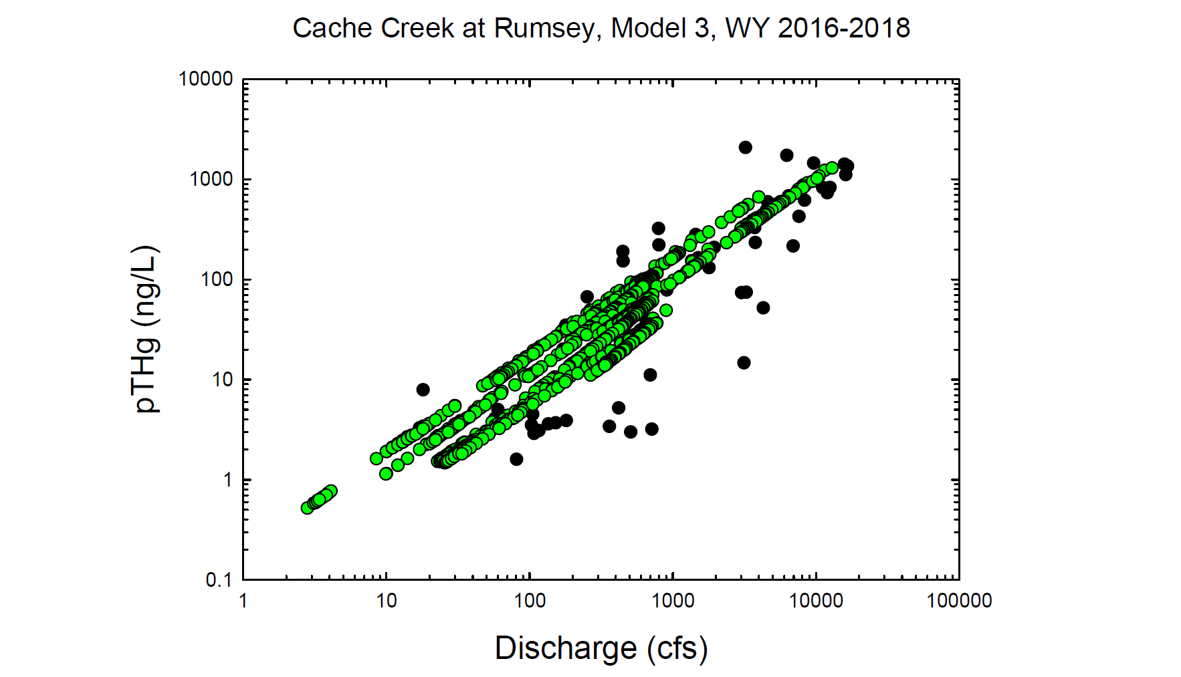
Black circles = Observed values
Green circles = Modeled values

Slide 2
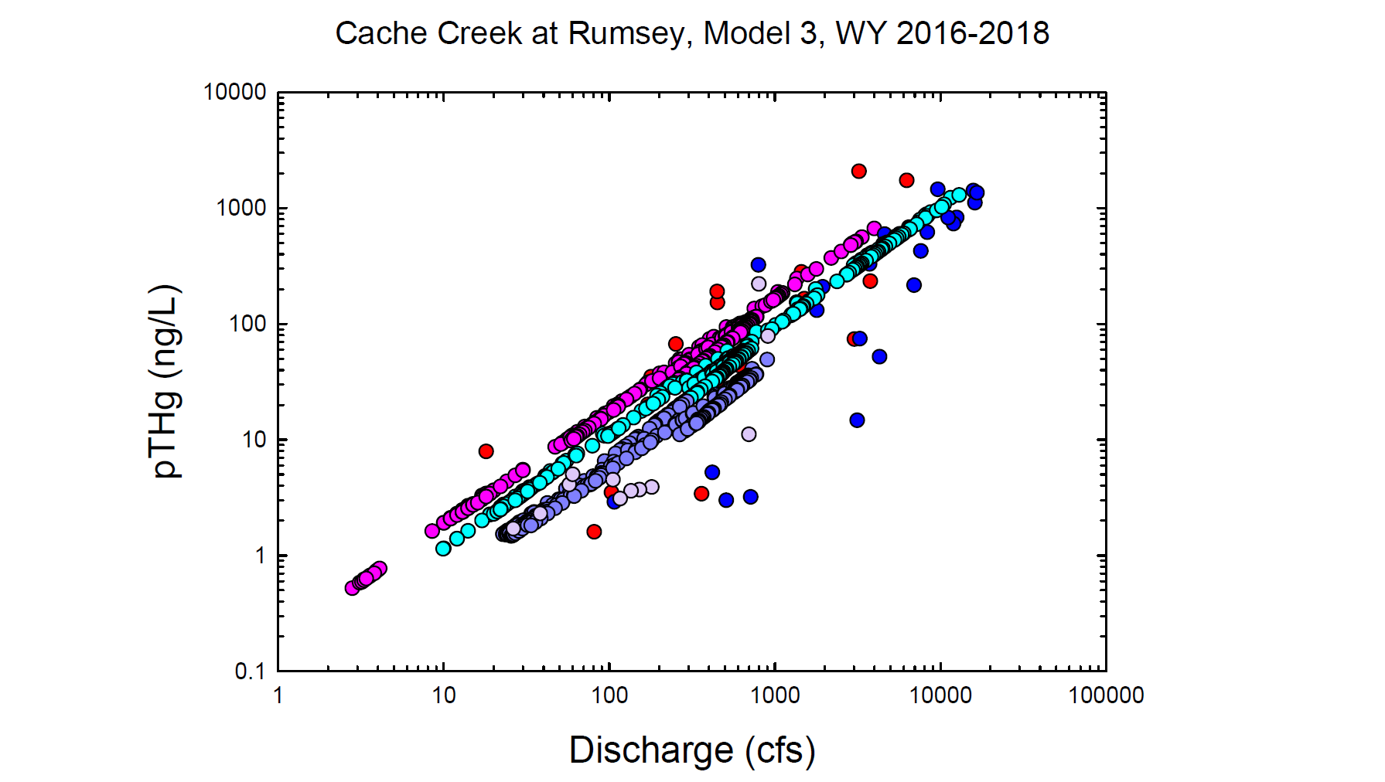
Red = Observed wy2016
Dk. Blue = Observed wy2017
Lt. Purple = Observed wy2018
Pink = Modeled wy2016
Lt. Blue = Modeled wy2017
Dk. Purple = Modeled wy2018

Slide 3
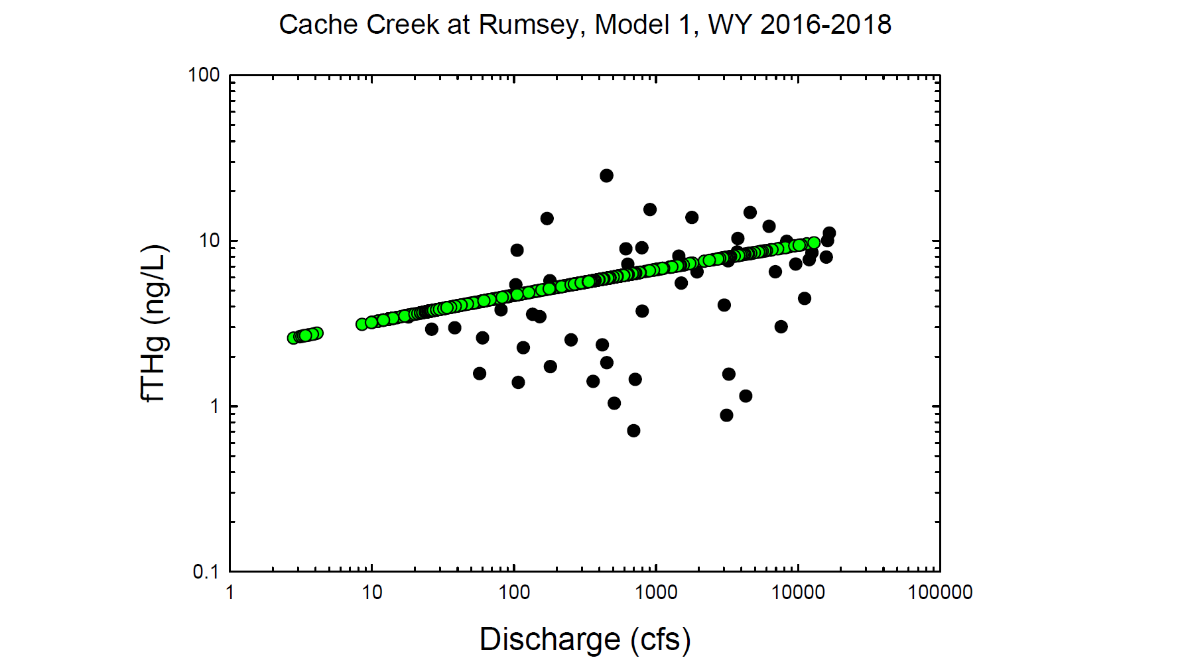
Black circles = Observed values
Green circles = Modeled values

Slide 4
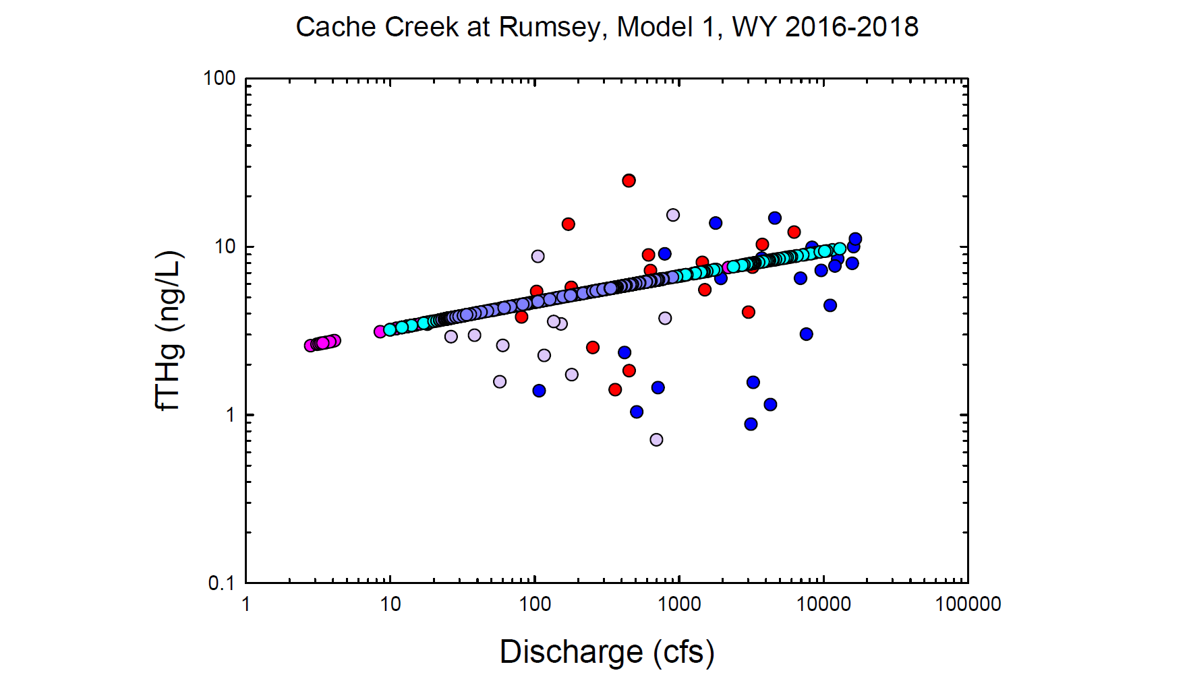
Red = Observed wy2016
Dk. Blue = Observed wy2017
Lt. Purple = Observed wy2018
Pink = Modeled wy2016
Lt. Blue = Modeled wy2017
Dk. Purple = Modeled wy2018

Slide 5
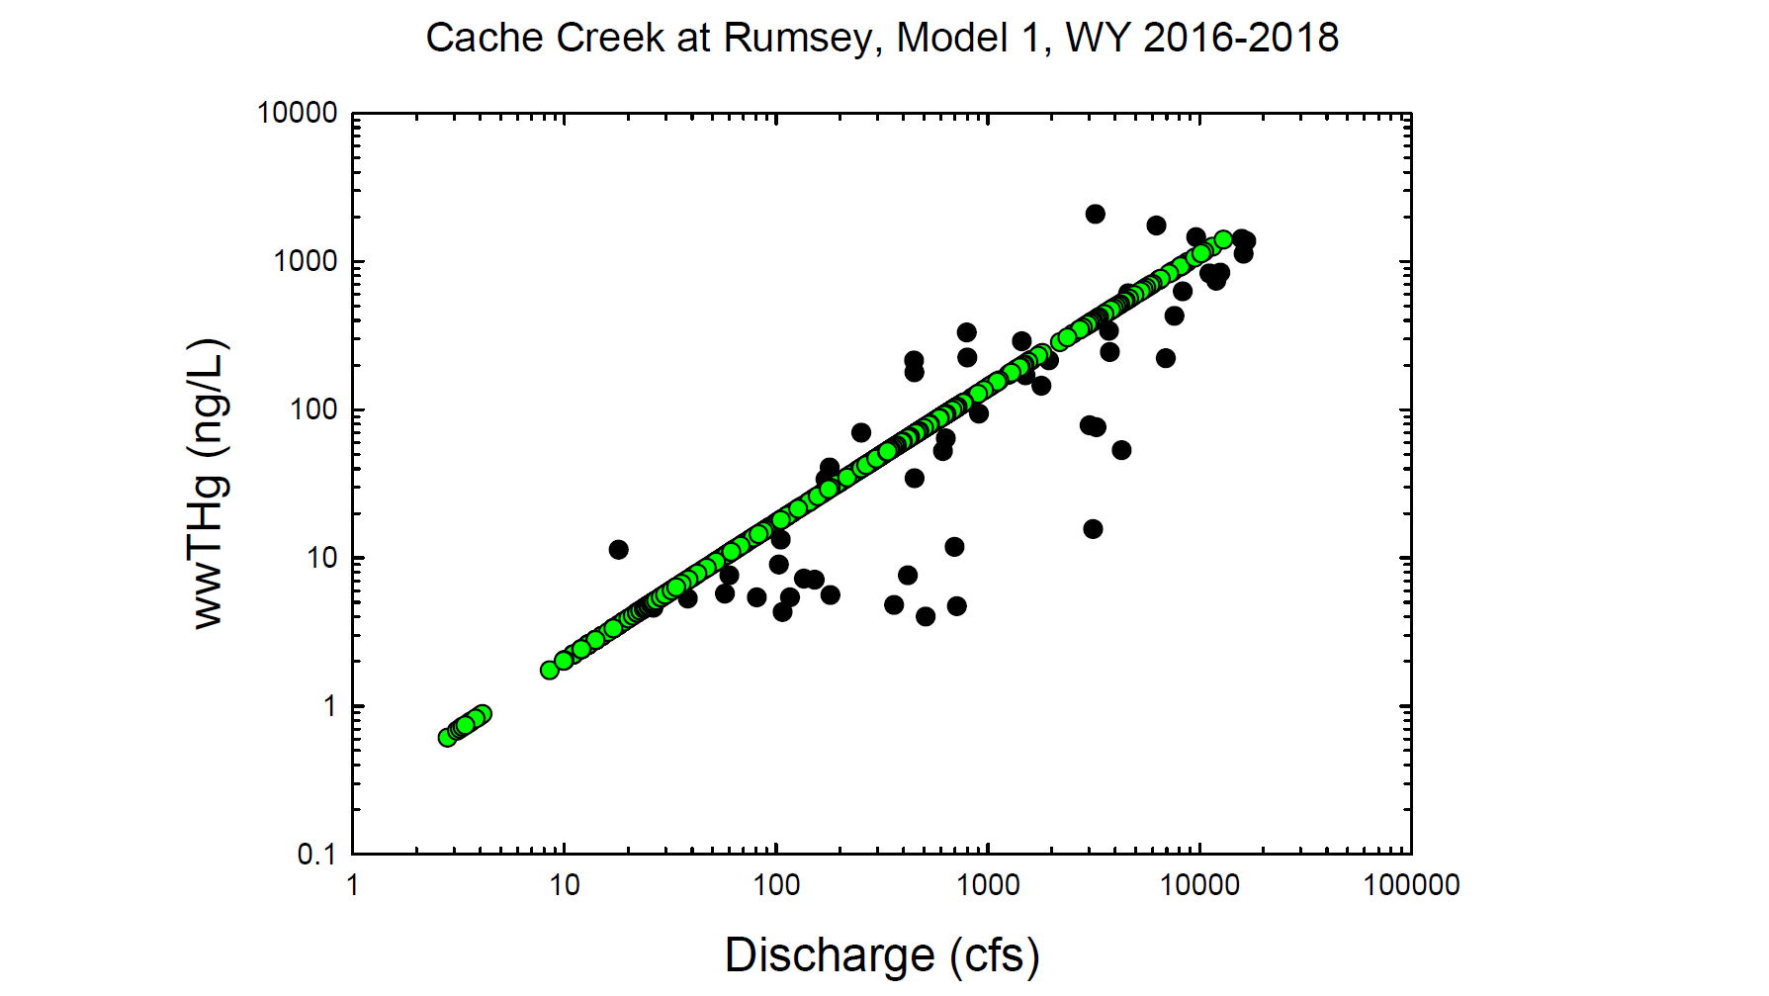
Black circles = Observed values
Green circles = Modeled values

Slide 6
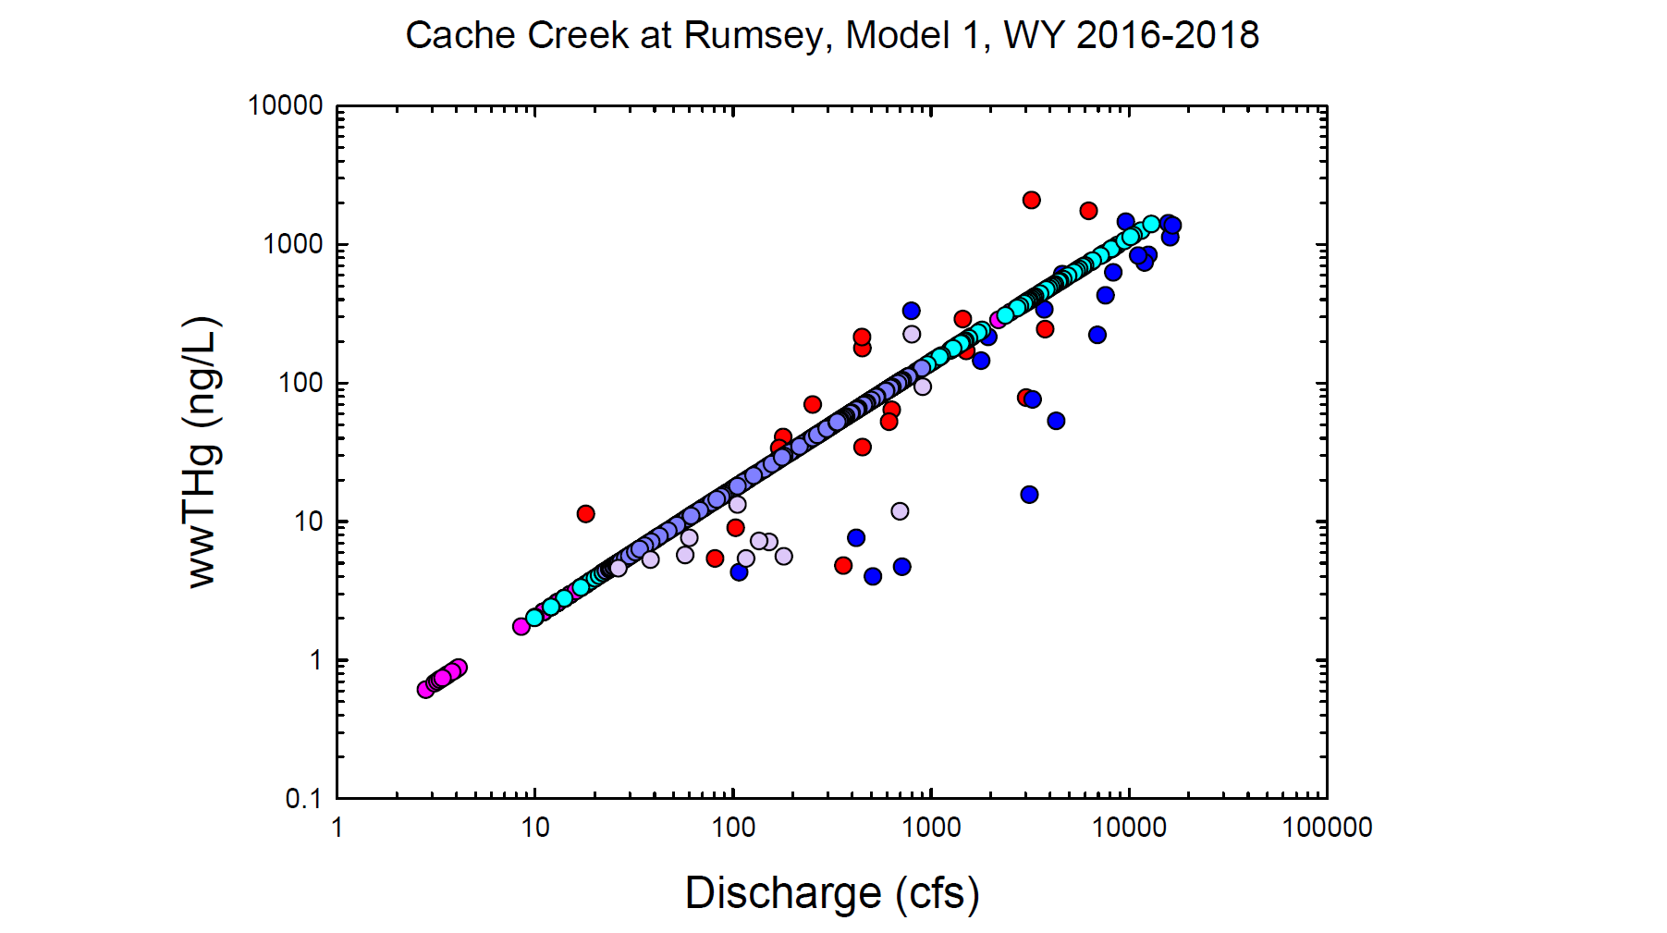
Red = Observed wy2016
Dk. Blue = Observed wy2017
Lt. Purple = Observed wy2018
Pink = Modeled wy2016
Lt. Blue = Modeled wy2017
Dk. Purple = Modeled wy2018

Slide 7
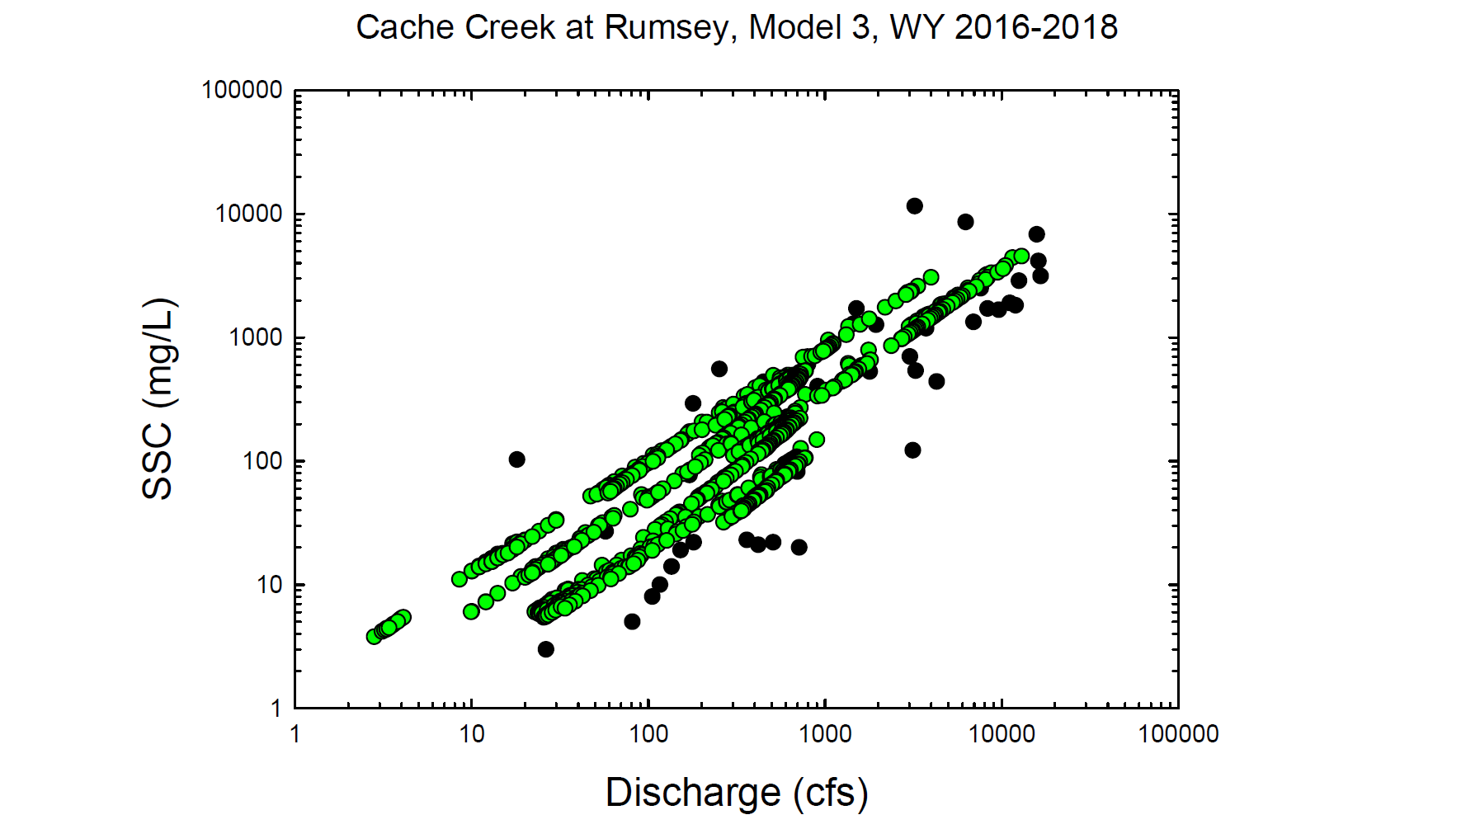
Black circles = Observed values
Green circles = Modeled values

Slide 8
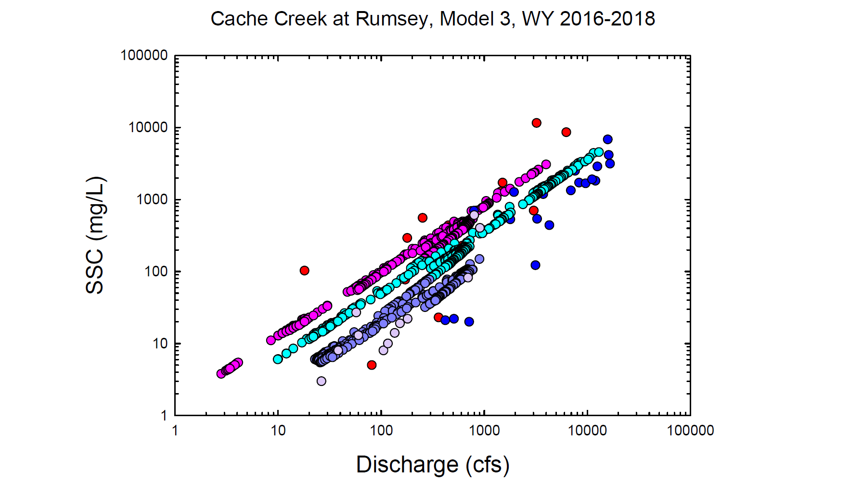
Red = Observed wy2016
Dk. Blue = Observed wy2017
Lt. Purple = Observed wy2018
Pink = Modeled wy2016
Lt. Blue = Modeled wy2017
Dk. Purple = Modeled wy2018

Slide 9
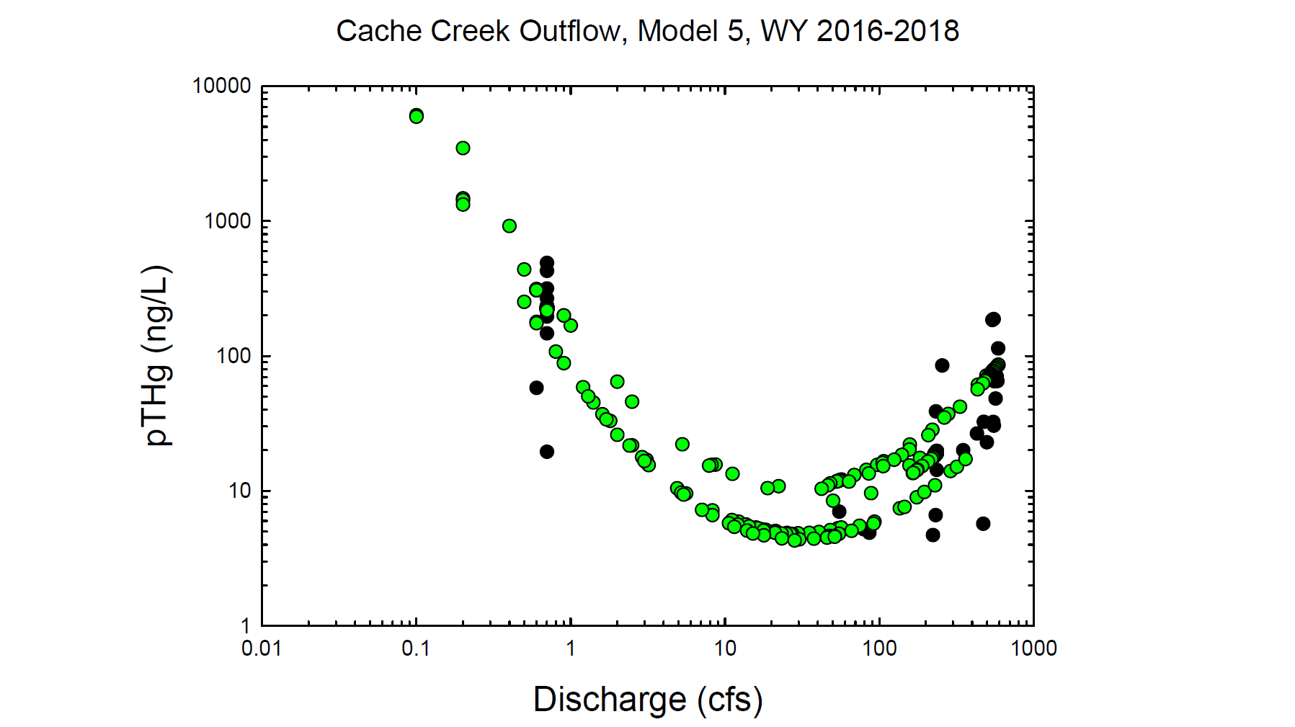
Black circles = Observed values
Green circles = Modeled values

Slide 10
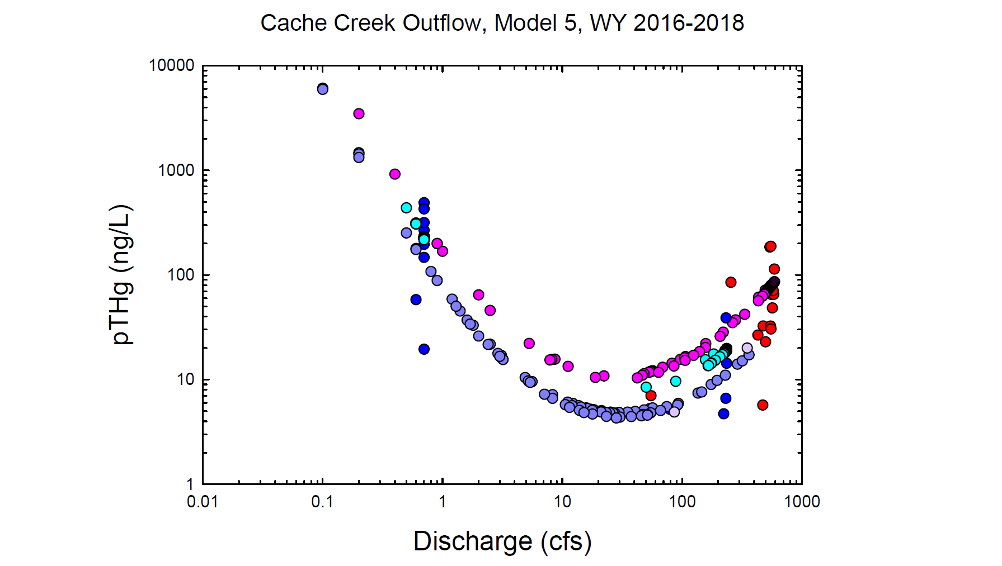
Red = Observed wy2016
Dk. Blue = Observed wy2017
Lt. Purple = Observed wy2018
Pink = Modeled wy2016
Lt. Blue = Modeled wy2017
Dk. Purple = Modeled wy2018

Slide 11
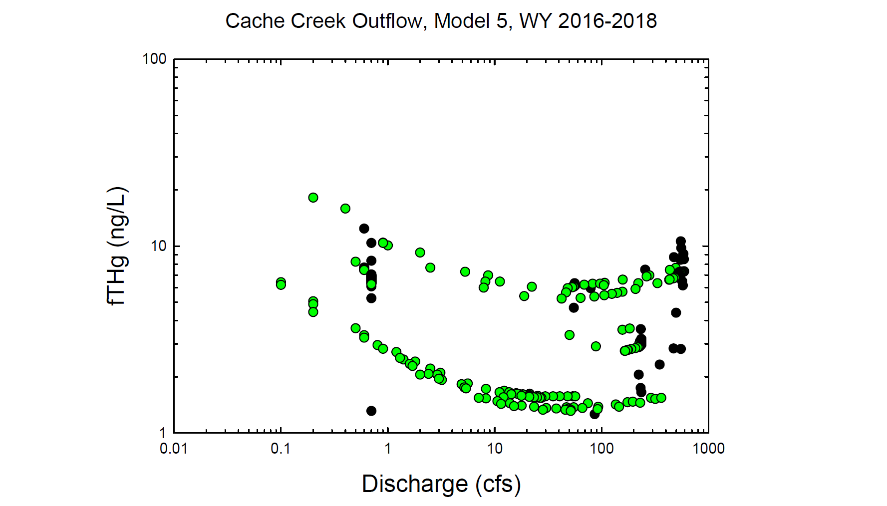
Black circles = Observed values
Green circles = Modeled values

Slide 12
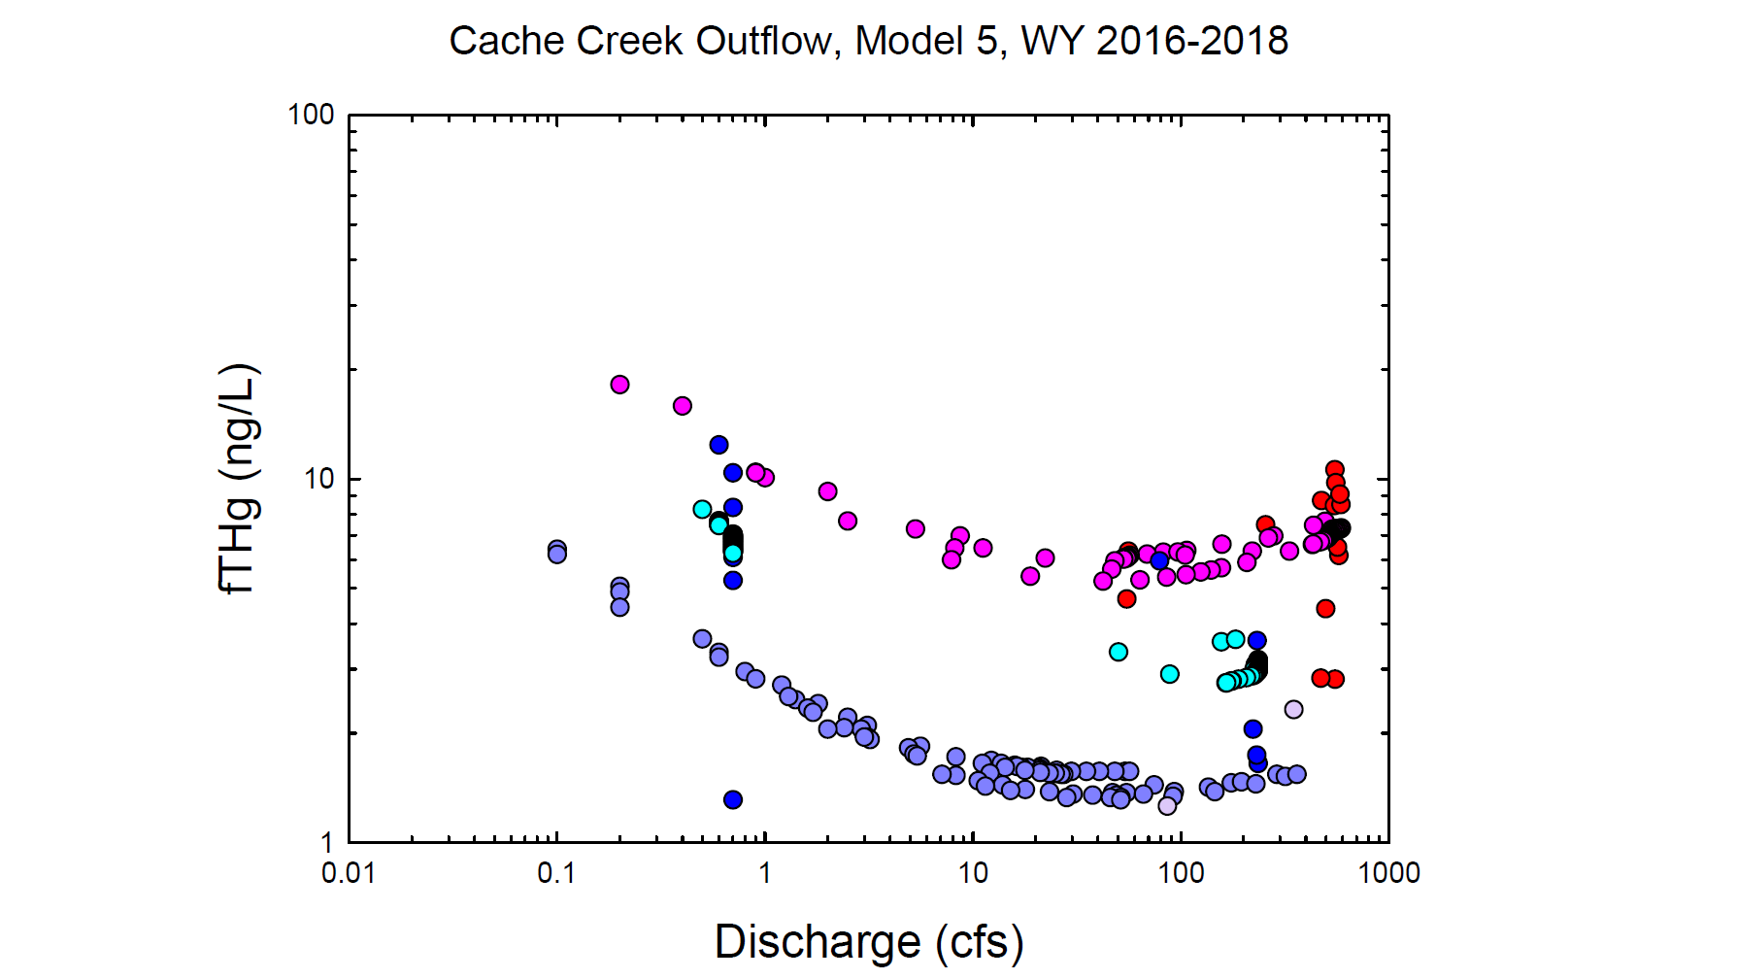
Red = Observed wy2016
Dk. Blue = Observed wy2017
Lt. Purple = Observed wy2018
Pink = Modeled wy2016
Lt. Blue = Modeled wy2017
Dk. Purple = Modeled wy2018

Slide 13
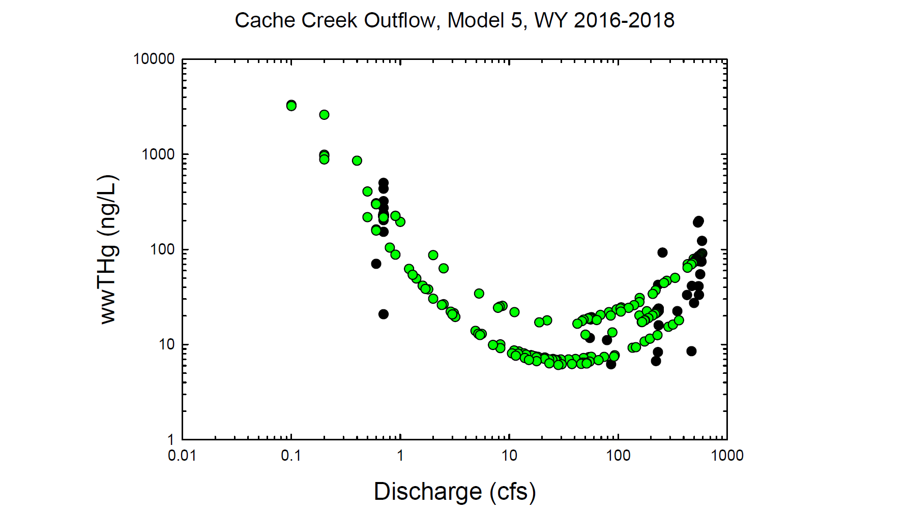
Black circles = Observed values
Green circles = Modeled values

Slide 14
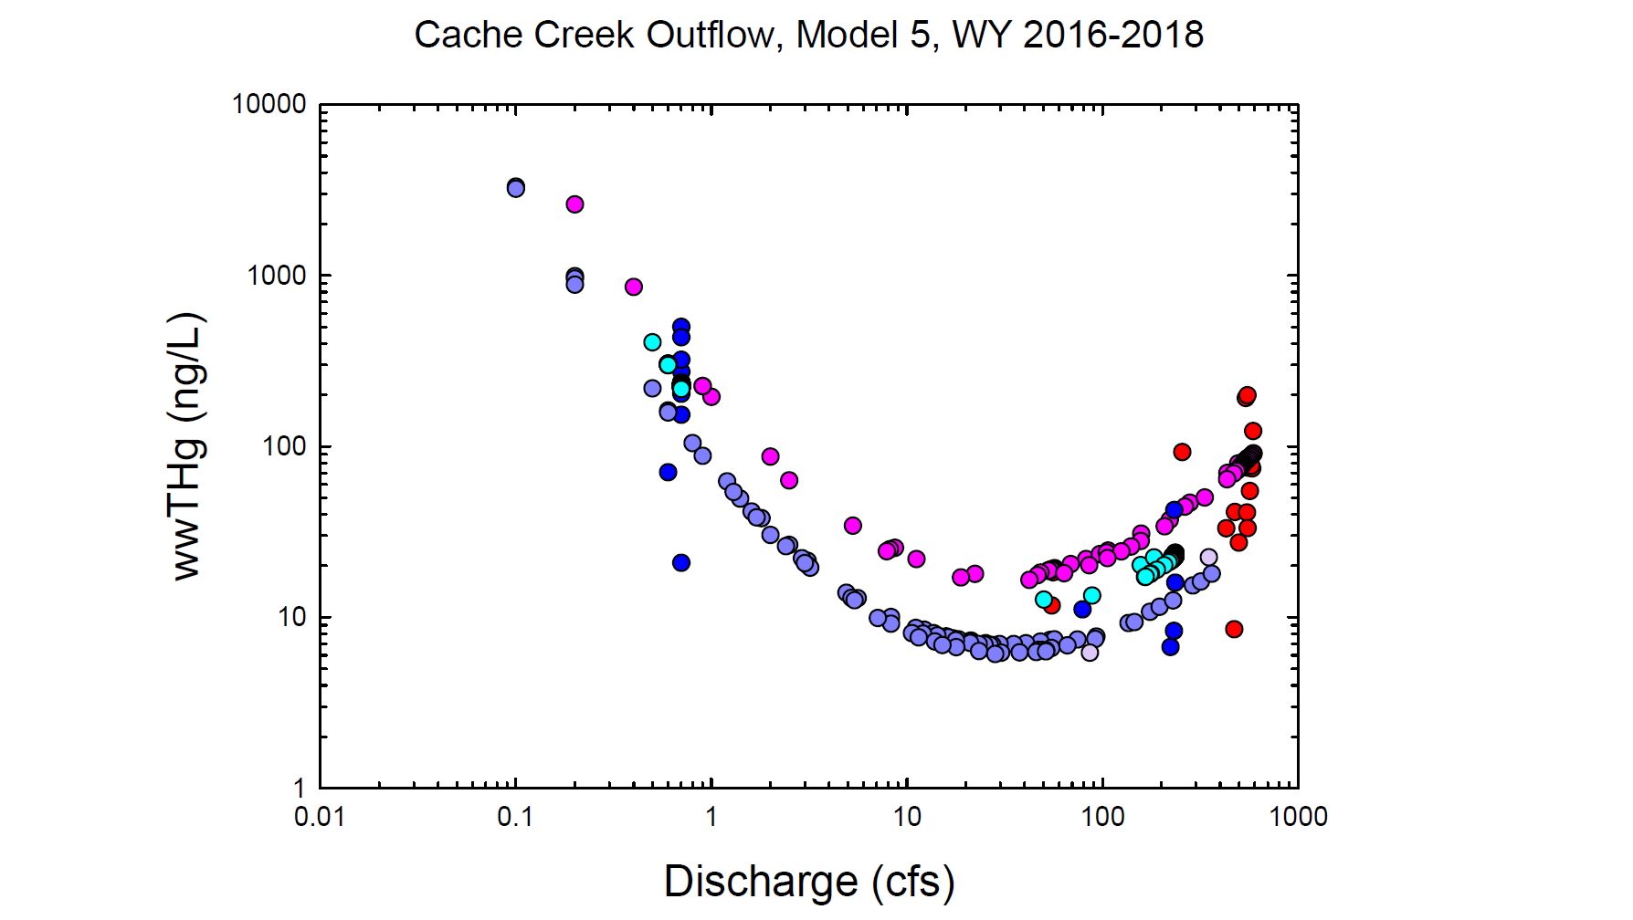
Red = Observed wy2016
Dk. Blue = Observed wy2017
Lt. Purple = Observed wy2018
Pink = Modeled wy2016
Lt. Blue = Modeled wy2017
Dk. Purple = Modeled wy2018

Slide 15
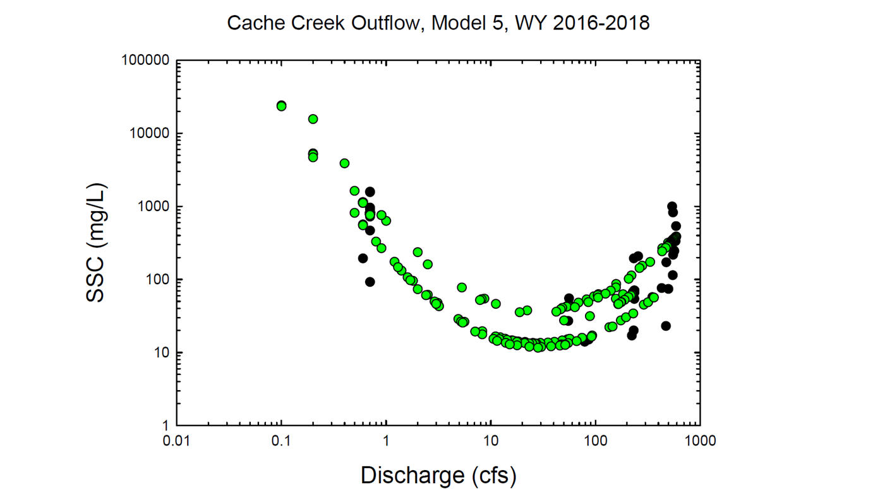
Black circles = Observed values
Green circles = Modeled values

Slide 16
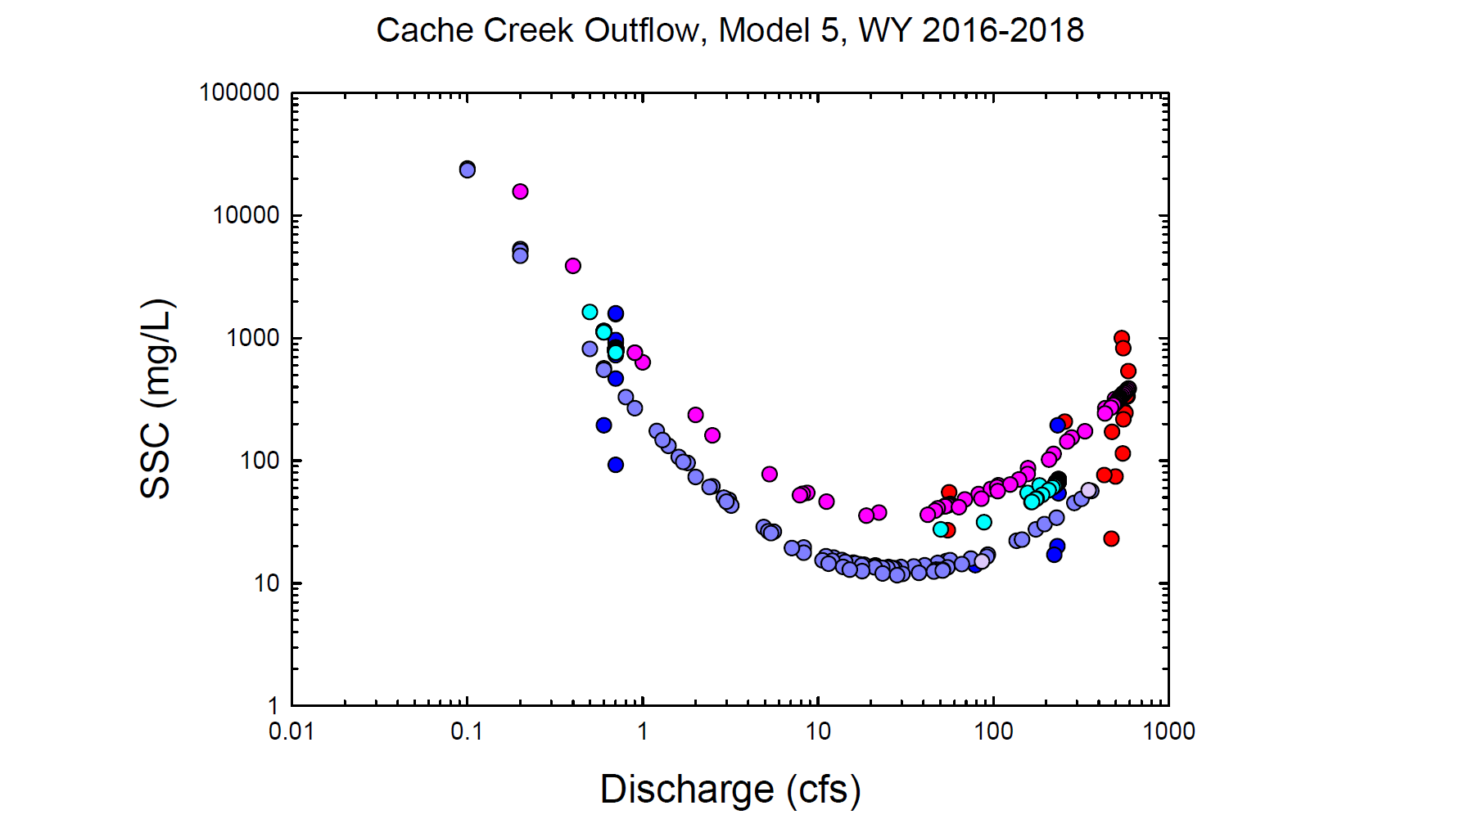
Red = Observed wy2016
Dk. Blue = Observed wy2017
Lt. Purple = Observed wy2018
Pink = Modeled wy2016
Lt. Blue = Modeled wy2017
Dk. Purple = Modeled wy2018

Slide 17
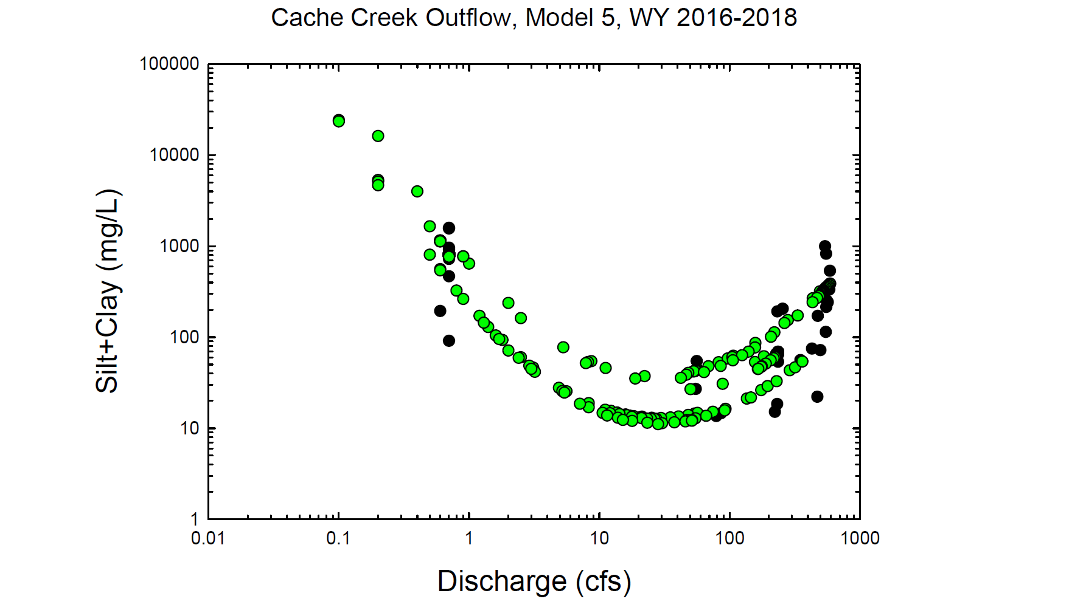
Black circles = Observed values
Green circles = Modeled values

Slide 18

Red = Observed wy2016
Dk. Blue = Observed wy2017
Lt. Purple = Observed wy2018
Pink = Modeled wy2016
Lt. Blue = Modeled wy2017
Dk. Purple = Modeled wy2018

Slide 19
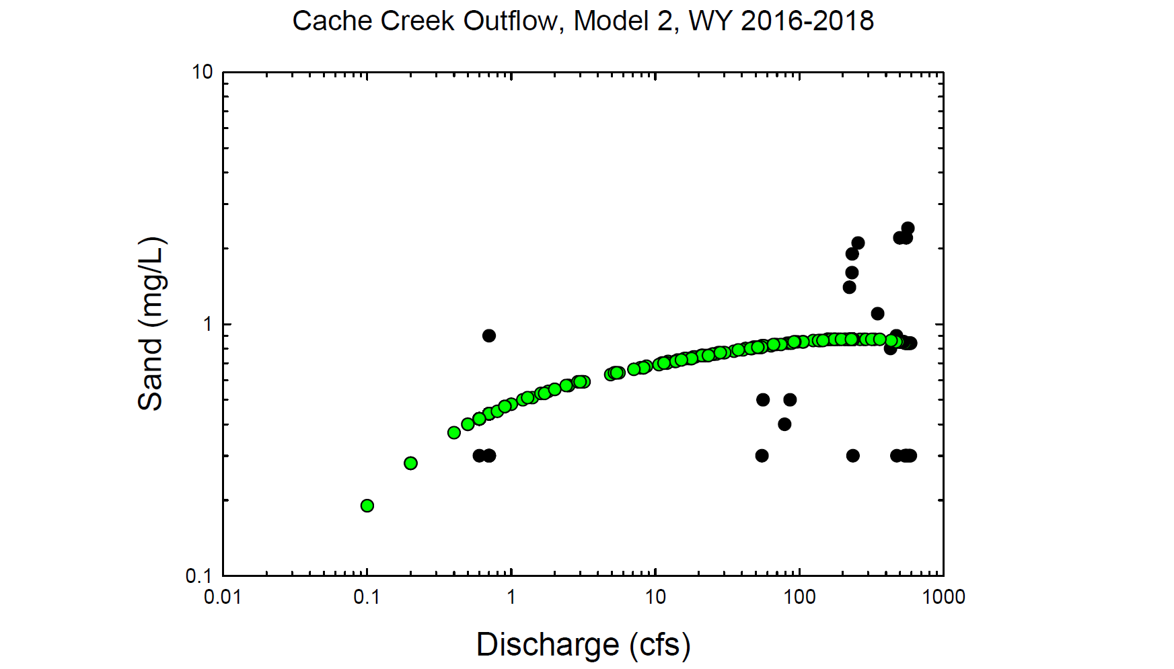
Black circles = Observed values
Green circles = Modeled values

Slide 20
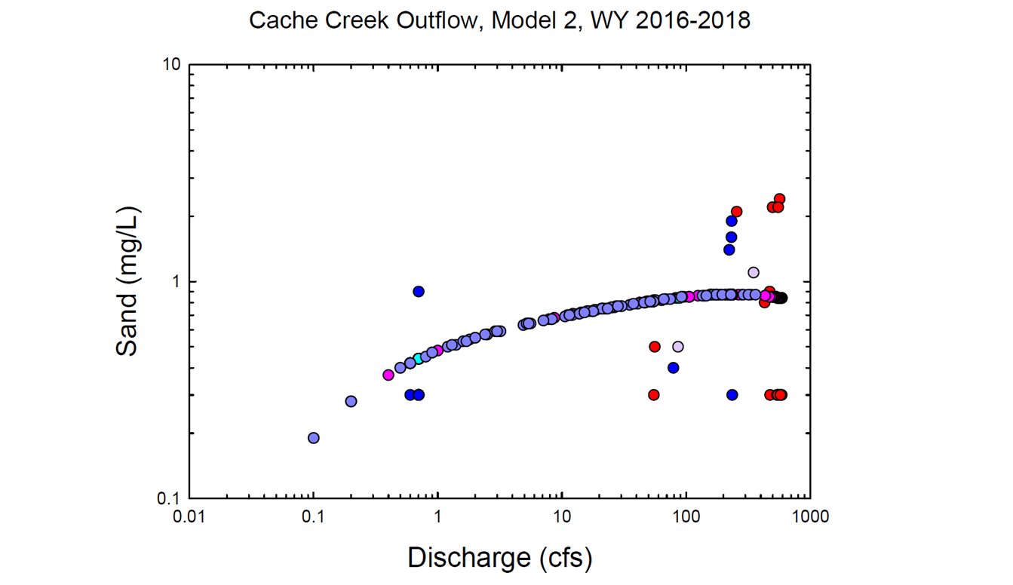
Red = Observed wy2016
Dk. Blue = Observed wy2017
Lt. Purple = Observed wy2018
Pink = Modeled wy2016
Lt. Blue = Modeled wy2017
Dk. Purple = Modeled wy2018

Slide 21
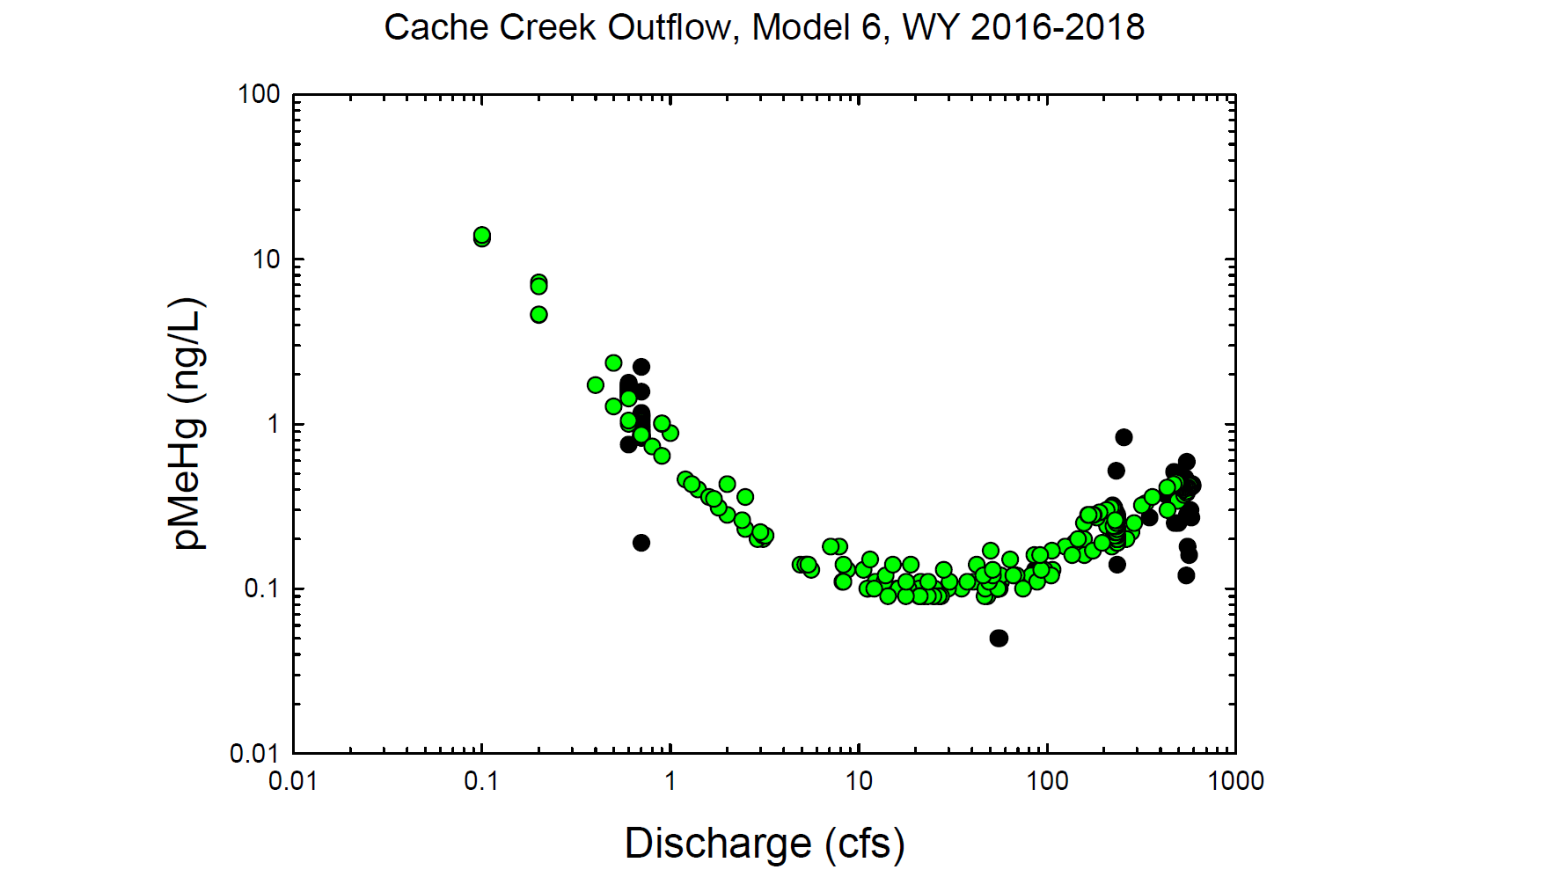
Black circles = Observed values
Green circles = Modeled values

Slide 22
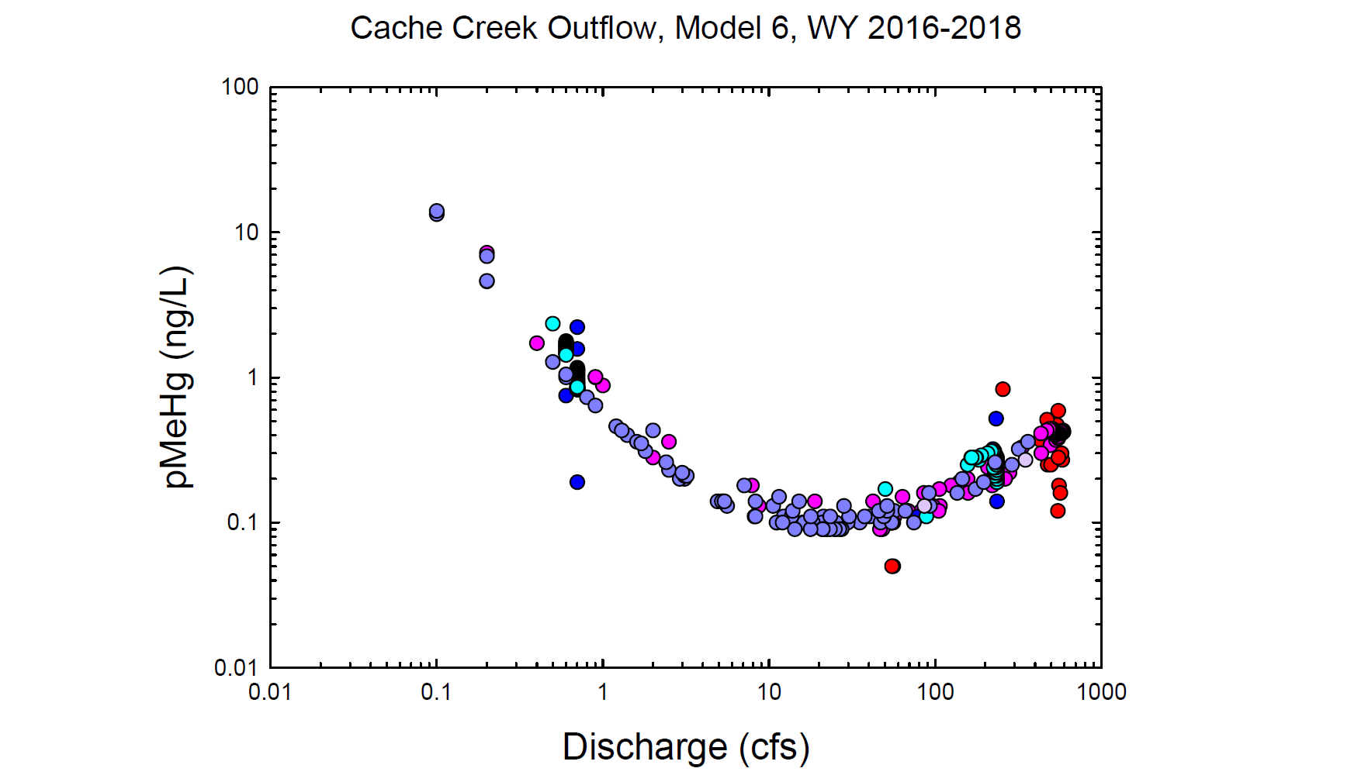
Red = Observed wy2016
Dk. Blue = Observed wy2017
Lt. Purple = Observed wy2018
Pink = Modeled wy2016
Lt. Blue = Modeled wy2017
Dk. Purple = Modeled wy2018

Slide 23
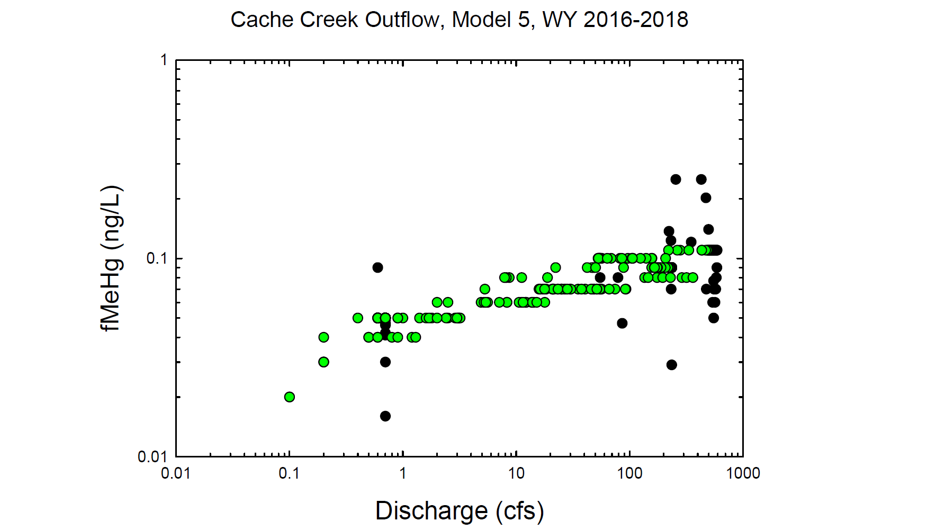
Black circles = Observed values
Green circles = Modeled values

Slide 24
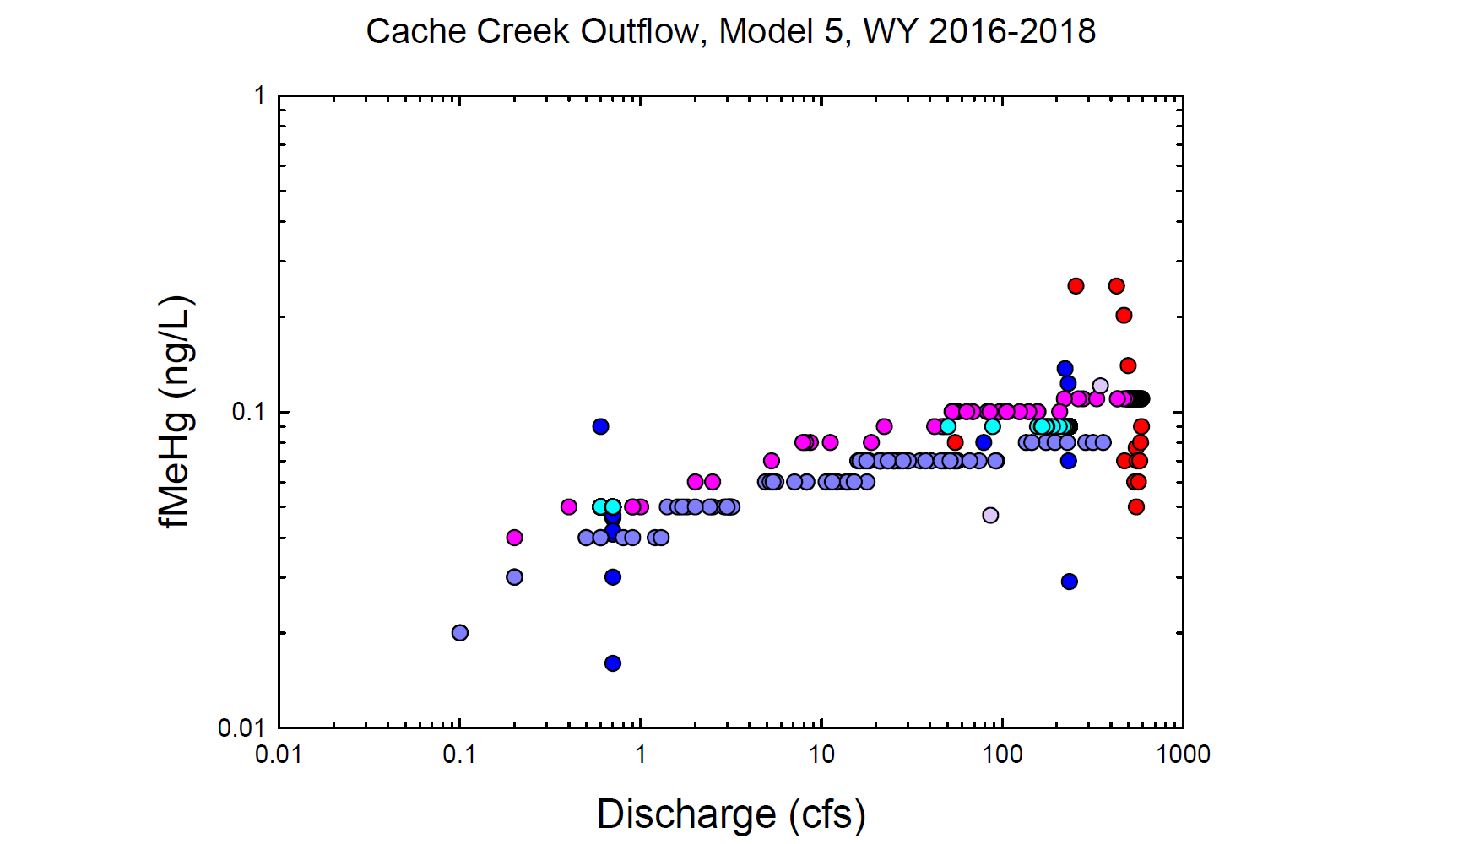
Red = Observed wy2016
Dk. Blue = Observed wy2017
Lt. Purple = Observed wy2018
Pink = Modeled wy2016
Lt. Blue = Modeled wy2017
Dk. Purple = Modeled wy2018

Slide 25
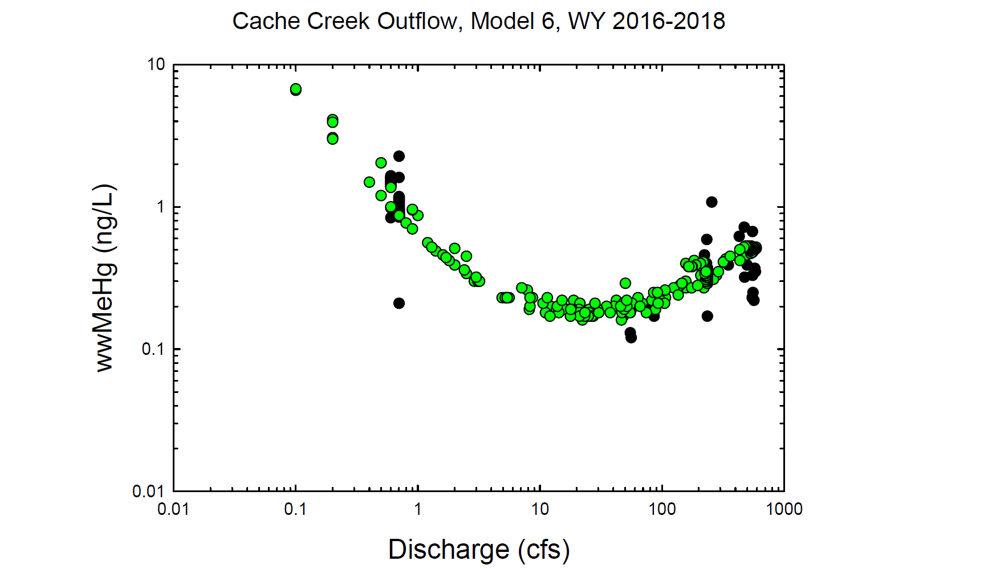
Black circles = Observed values
Green circles = Modeled values

Slide 26
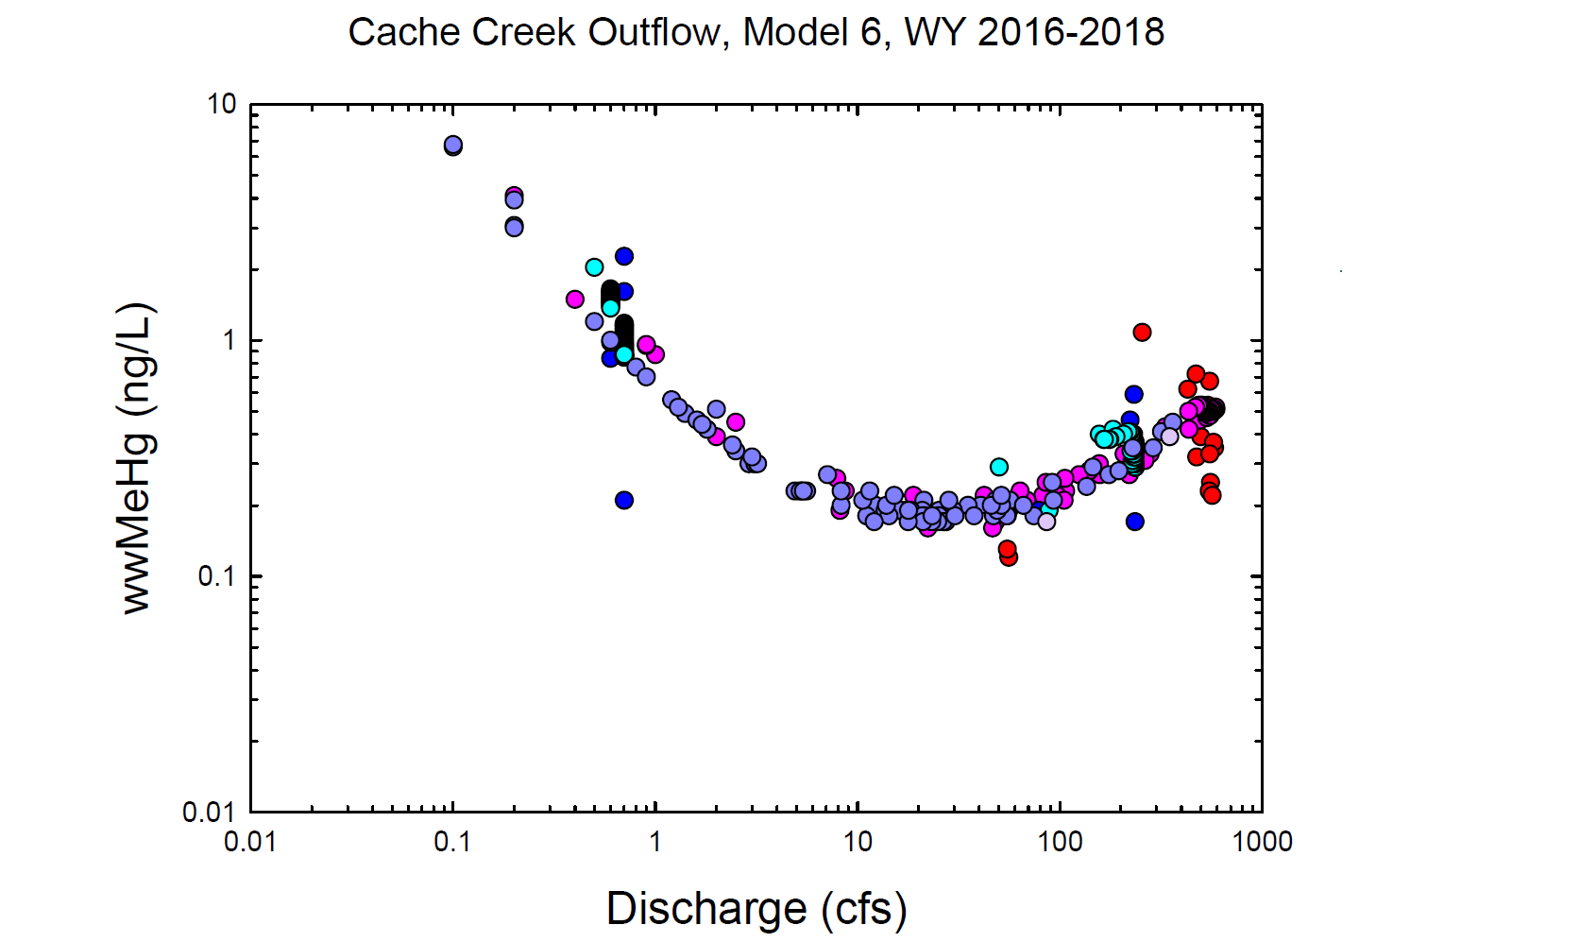
Red = Observed wy2016
Dk. Blue = Observed wy2017
Lt. Purple = Observed wy2018
Pink = Modeled wy2016
Lt. Blue = Modeled wy2017
Dk. Purple = Modeled wy2018

Slide 27
Black circles = Observed values
Green circles = Modeled values

Slide 28
Red = Observed wy2016
Dk. Blue = Observed wy2017
Lt. Purple = Observed wy2018
Pink = Modeled wy2016
Lt. Blue = Modeled wy2017
Dk. Purple = Modeled wy2018

